Slide 1
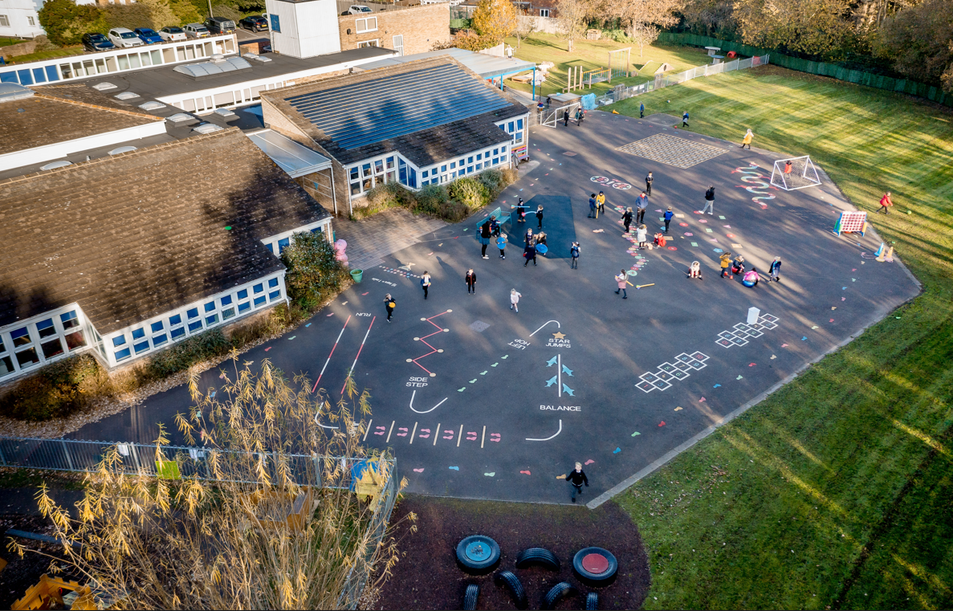

Weston Shore Infant School - Open Days
Tuesday 29th September 9.15am - 9.45am - Parent/Carers only
11.00am -11.30am - Parent/Carers only
1.15pm - 1.45pm - Parent/Carers only
Thursday 8th October 3.15pm - 4.00pm - All welcome
Thursday 15th October 3.15pm - 4.00pm - All welcome
Tuesday 20th October 9.15am - 9.45am - Parent/Carers only
11am - 11.30am - Parent/Carers only
1.15pm-1.45pm - Parent/Carers only
Wednesday 4th November 9.15am - 9.45am - Parent/Carers only
11am - 11.30am - Parent/Carers only
1.15pm-1.45pm - Parent/Carers only
Outstanding Early Years: ‘The environment is impressively well thought through…’
‘Pupils behave exceptionally well.’
Ofsted 2023
Be responsible. Be a learner. Be respectable. Be safe.

